Slide 1
Music (and Education) and technological affordances; reflections of re/living public outreach repertoire performed by the Second Straits Settlement Police Band in early 20th century Singapore.
Dairianathan, E., Ooi, M. Tan, Y.L., Yusri, M.,
National Institute of Education,
Nanyang Technological University,

Slide 2
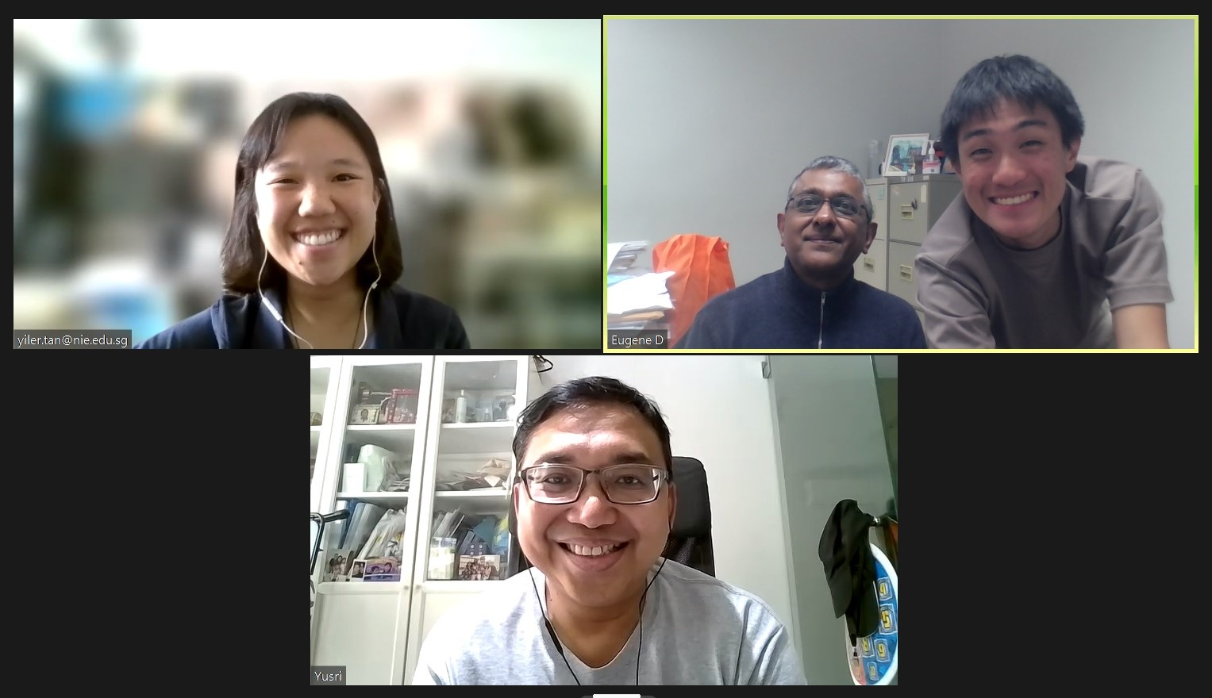
The Team!

Slide 3
Caveat
Views expressed in this presentation are the research team’s and do not represent the views of an/y institution.

Slide 4
Acknowledgements
This presentation acknowledges:
Funding from an academic grant from the National Institute of Education, Nanyang Technological University, Singapore (NIE AcRF RI 5-20 ED).
The Singapore Police Force Band, legal owners of the Second Straits Settlement Police Band (SSSPB) collection, for permission to use excerpts of the The Beggars Opera, Chu Chin Chow and The Orchid for this presentation.
Support and assistance from the National Archives of Singapore, custodians of the SSSPB/Singapore Police Force Band collection, for providing digitized scores.

Slide 5
Synopsis
An account of the tasks, challenges and solutions to the digital conversions of – individual instrumental part scores and piano (conductor) part – into full wind ensemble format and digital audio realization.
Soundscapes, through technological affordances, of public performances in Singapore through the Second Straits Settlement Police Band (SSSPB hereafter) formed in 1925 (Singapore Police Force Band today).​
Reflections of the place of technological affordances, g/local music heritage, and implications for school-based through IHL-based and community wind ensembles.

Slide 6
Outline
Tasks
Method
Challenges and Decisions
The Beggars Opera, Chu Chin Chow and The Orchid (excerpts)
Records of public performances in Singapore.
The Second Straits Settlement Police Band (SSSPB)
Technology and Affordances
Reflections

Slide 7
Selected Repertoire
  Beggars Opera (John Gay revival by Frederic Austin)
  Premiered June 7 1920 (Lyric Theatre, Hammersmith, London, UK)
  1,463 performances
  Chu Chin Chow (Frederic Norton orchestrated by Percy Fletcher)
  Premiered 31 August 1916 (His Majesty’s, UK)
  2238 performances
  The Orchid (Caryl/Monckton/Ross/Percy Greenbank)
  Premiered 26 October 1903 (Gaiety Theatre, UK)
  559 performances.

Slide 8
Tasks
  ‘Bringing-back-to-life’ musical repertoire performed by SSSPB formed in 1925.
  Digital realisation took two forms:
  Conversion of individual instrumental parts into a hitherto unavailable full orchestral format,
  Digital audio realisation of selected repertoire.

Slide 9
Method
  215 pieces were provided for by the National Archives in the form of part scores and a piano full score.
  AVID software was purchased to aid in the transcription of all 215 scores, specifically NotateMe (PhotoScore & NotateMe Ultimate - Avid) and Sibelius Ultimate (Music Notation Software – Sibelius – Avid).
  NotateMe was initially used to convert the part scores that were in Adobe PDF (.pdf) format into Sibelius (.sib) scores.

Slide 10
Method
  The various instrumental part scores would then be combined into a full wind ensemble score.
  This would then translate into a digital audio realization.

Slide 11
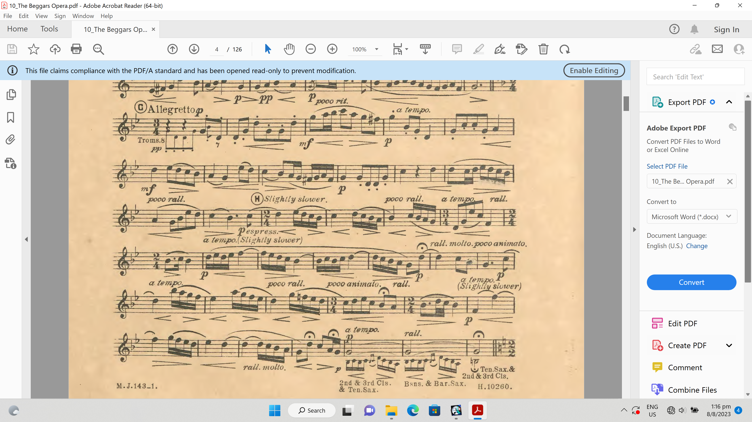
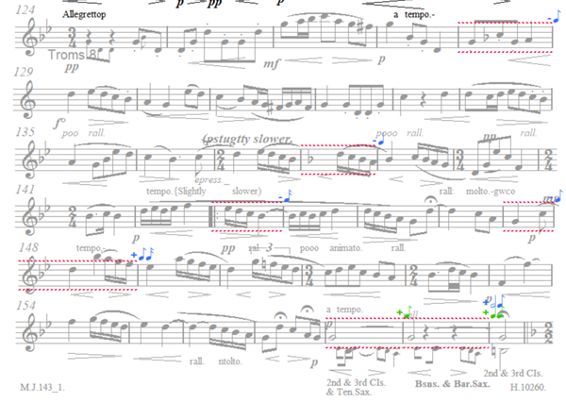
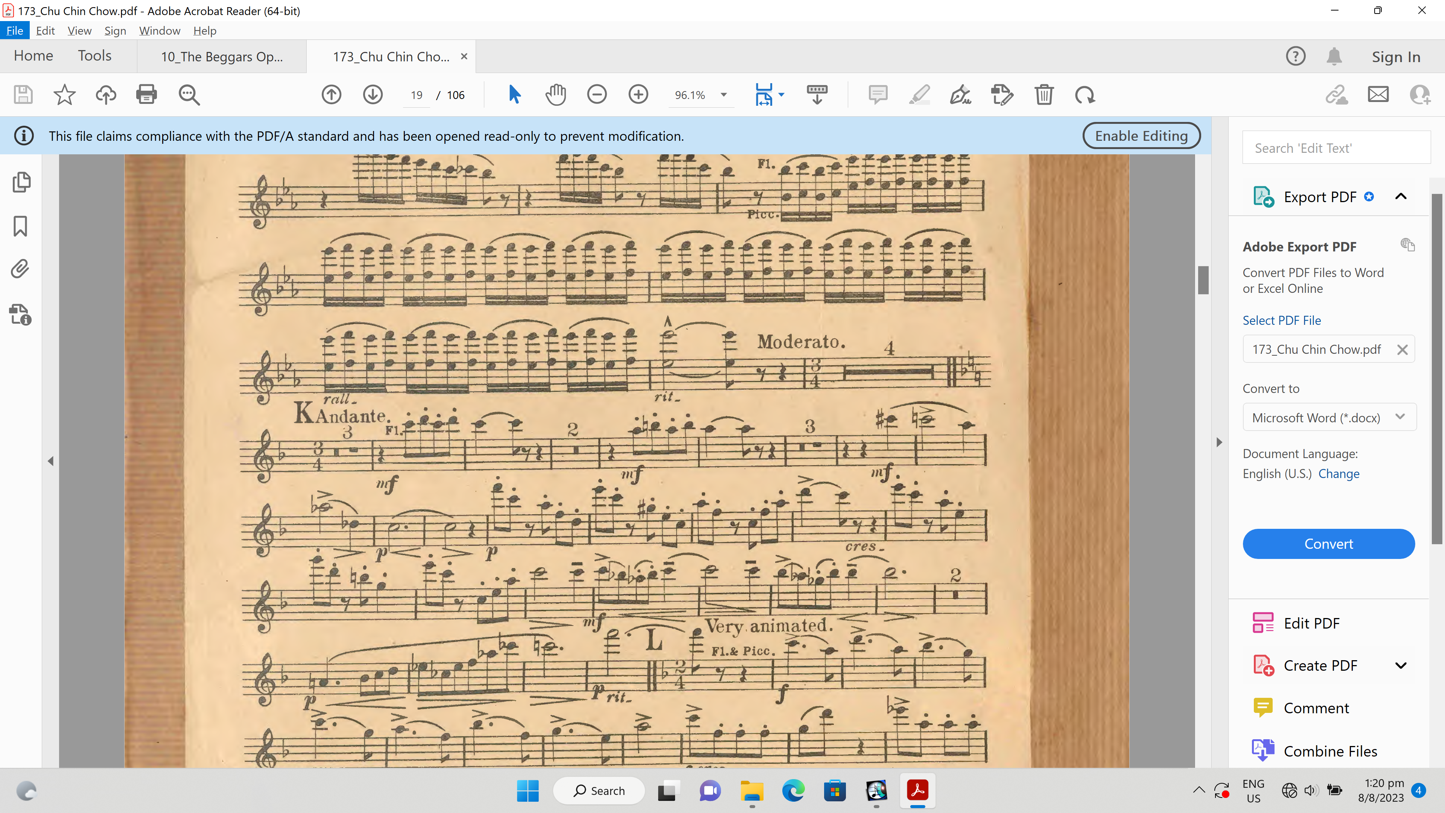
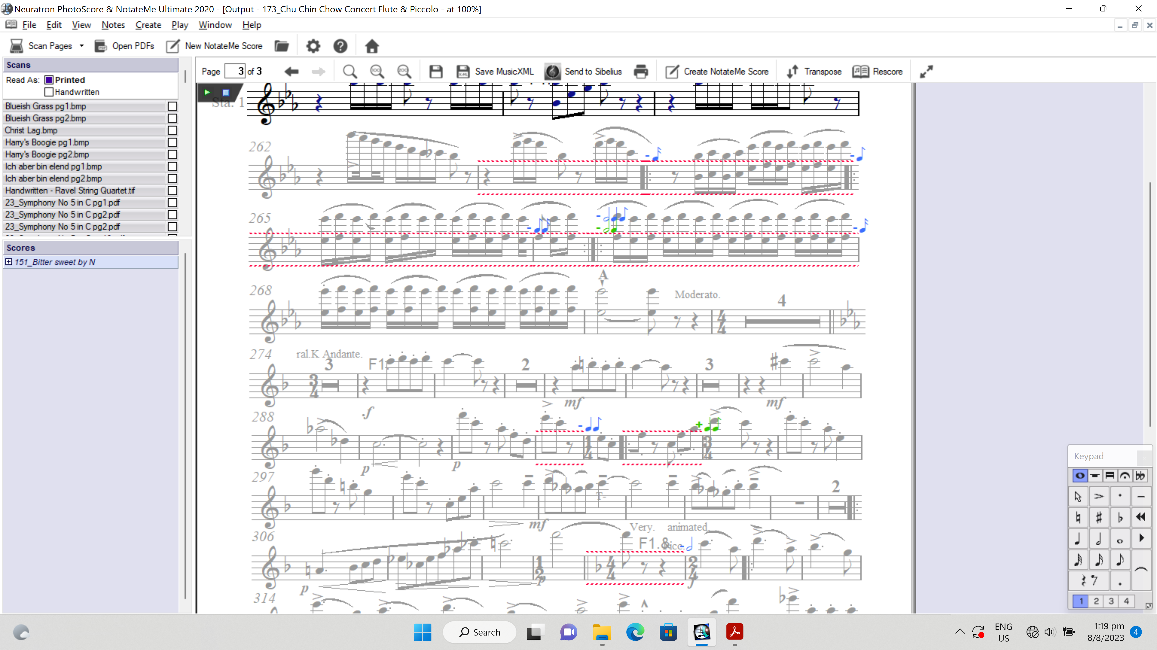
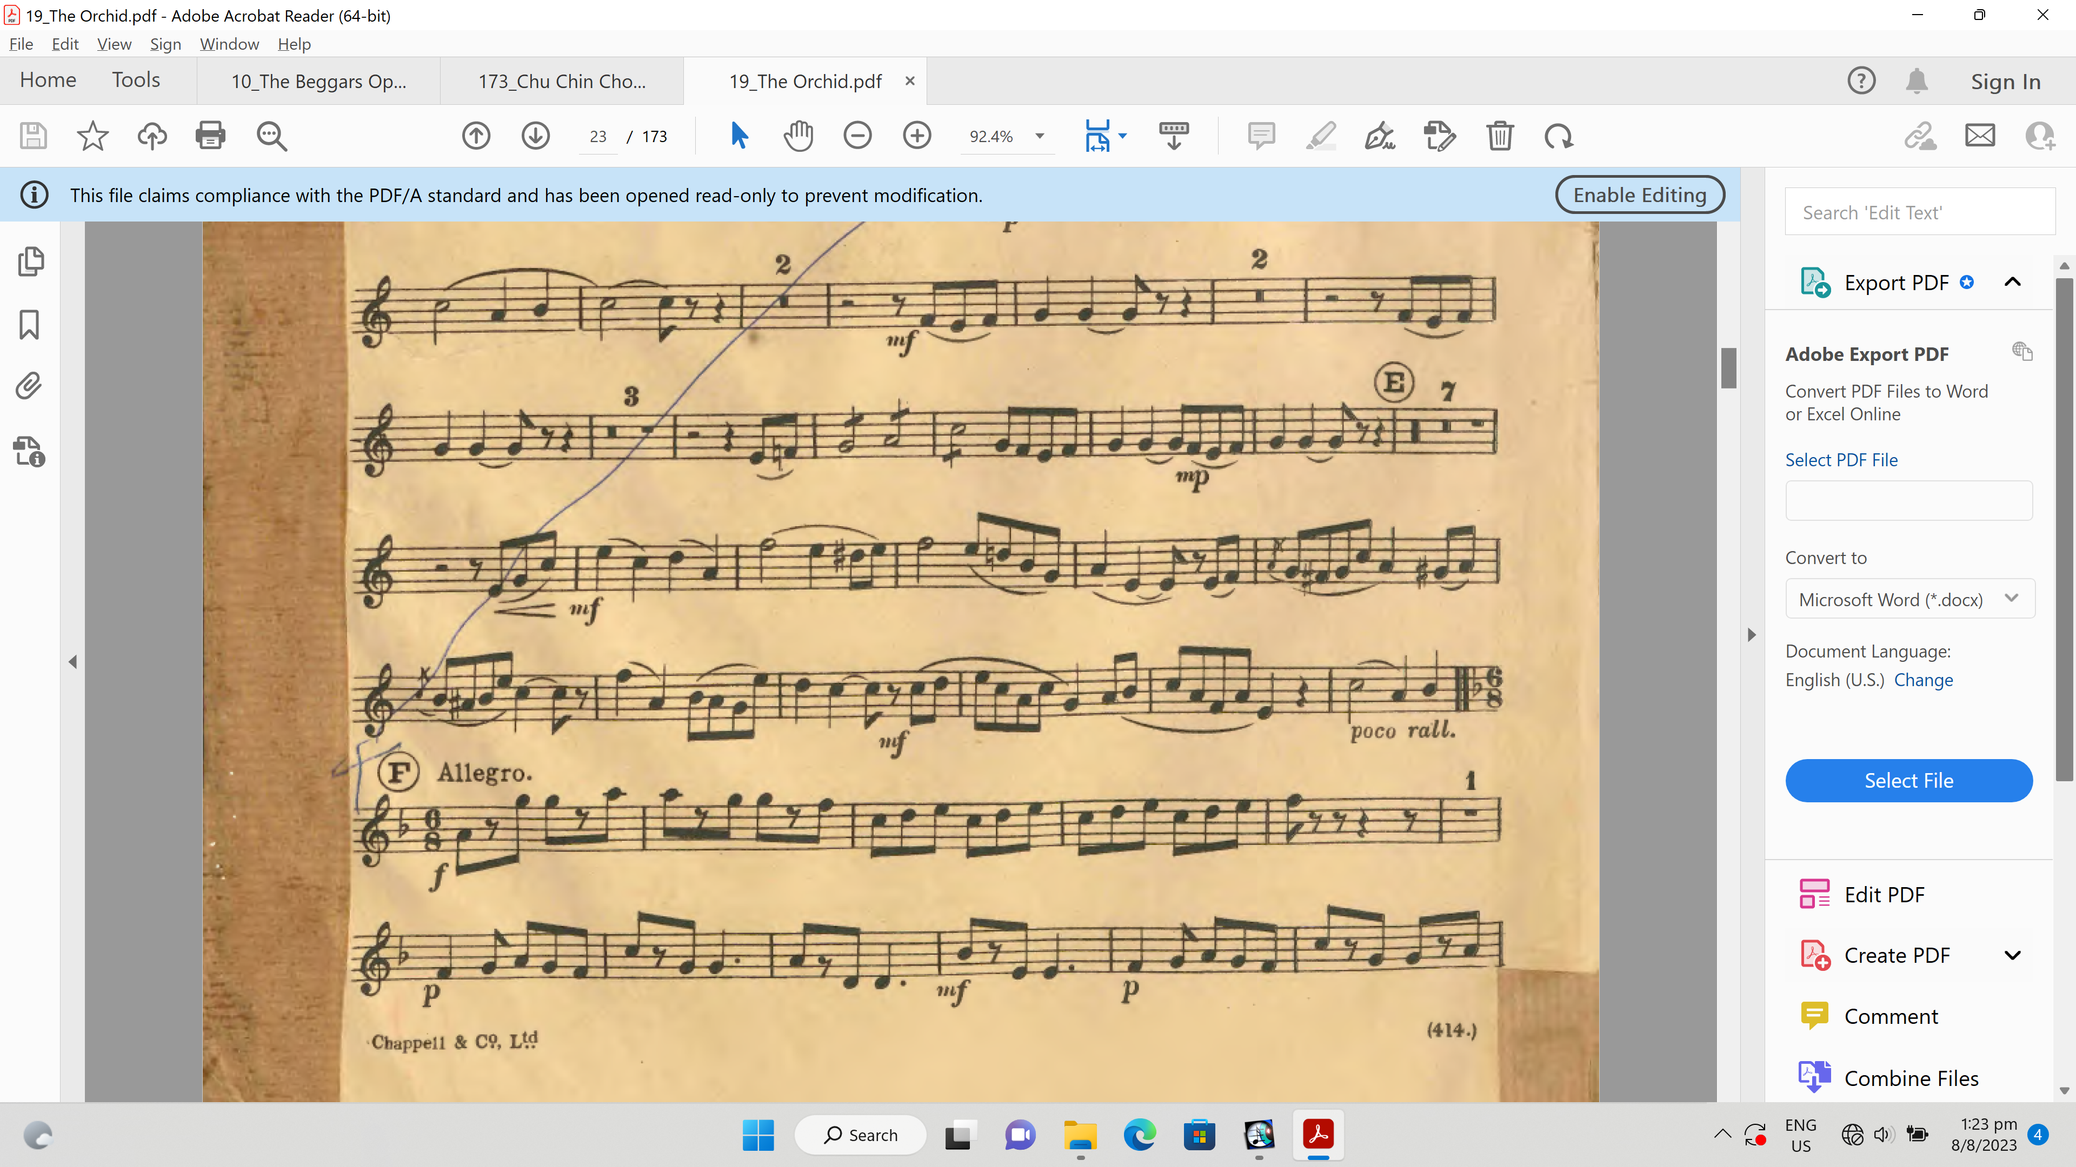
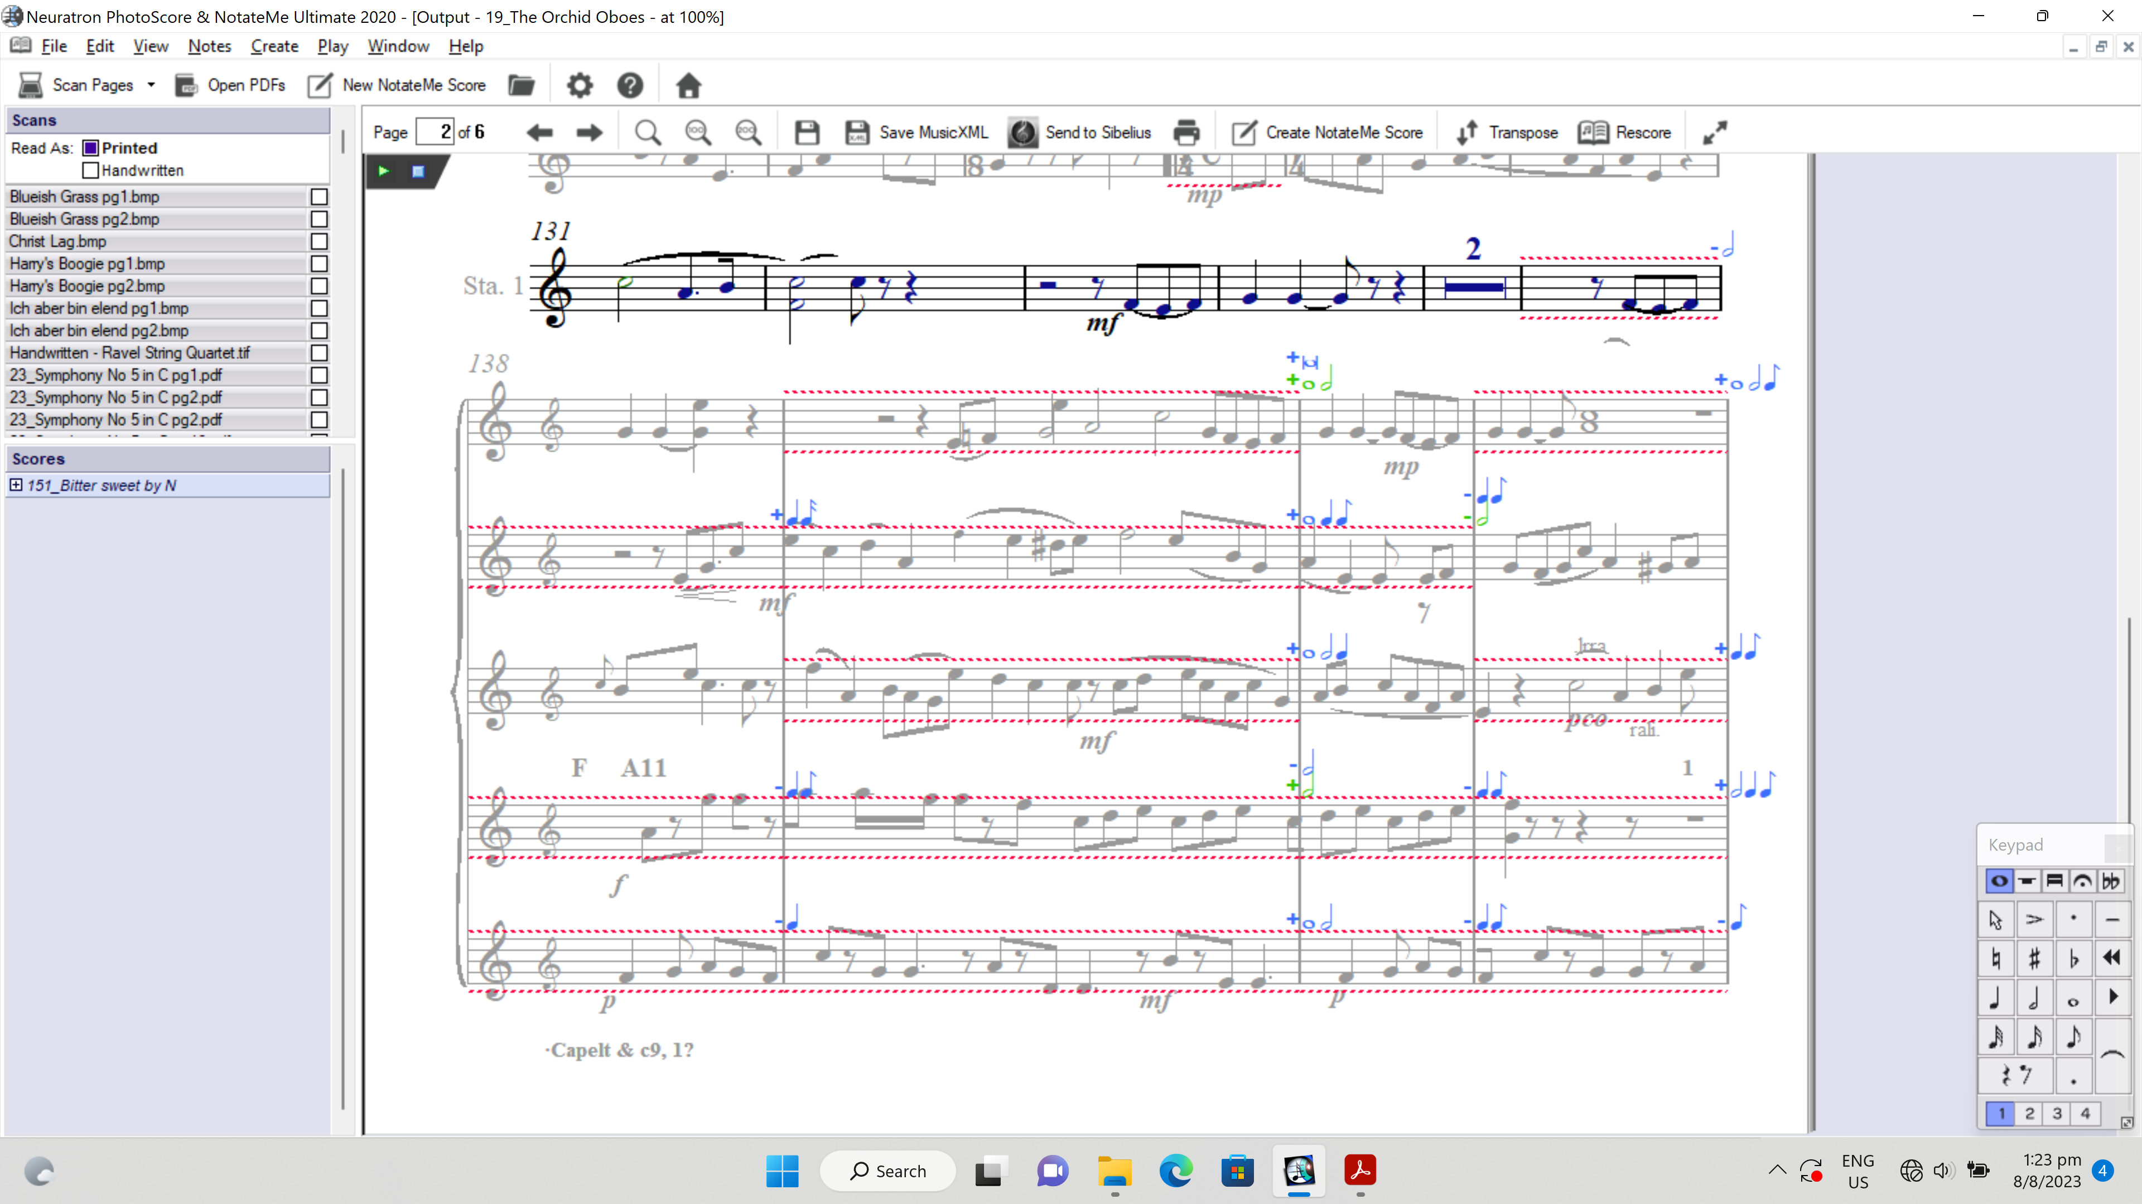
Method
Piece | Original PDF File | NotateMe File
Beggars’ Opera
Chu Chin Chow
The Orchid

Slide 12
Challenges and Decisions
Problem/Limitation | Mitigating Decisions
Original scores had taped pages, manual markings, handwritten notes, torn sections | Transcription involved making educated decisions/guesses for notes that were unclear due to the tears/tape on the individual part scores. Handwritten notes were transcribed in place of the printed notes All these notes were coloured and recorded down
Some discrepancies in time signatures, number of bars, note values and articulation were observed across parts | For differences in time signature, rhythms were changed to appropriately fit in the supposed time signature. Other parts were referenced to transcribe the appropriate note values, articulation and missing bars.
Due to the large number of parts, many of the parts and notes on the full wind ensemble score were overlapping. | The stave size was reduced, and bars were manually stretched to reduce the number of overlapped notes in the full wind ensemble score.

Slide 13
Challenges and Decisions
Problem/Limitation | Mitigating Decisions
Individual instrumental parts were missing in the original score provided, E.g., Bassoon 2 was present but not Bassoon 1 parts. | Individual instrumental parts were not substituted.
Eb Flute & Piccolo part for all pieces were transposed in the wrong key. | It was observed that the Eb Flute & Piccolo part was the same as the Concert Flute & Piccolo part. Therefore, the Concert Flute & Piccolo parts were doubled in the full score.
Due to AVID Sibelius’ pre-programming, tempo directions that were not in Italian/German terms did not have a suitable BPM during the playback. | A BPM that was deemed suitable for the sections was specified.
The original audio plugin, Sibelius sounds, was acceptable but the sounds were not realistic enough. | To enhance the digital realization further, NotePerformer3 software was added as an audio plugin on Sibelius.

Slide 14
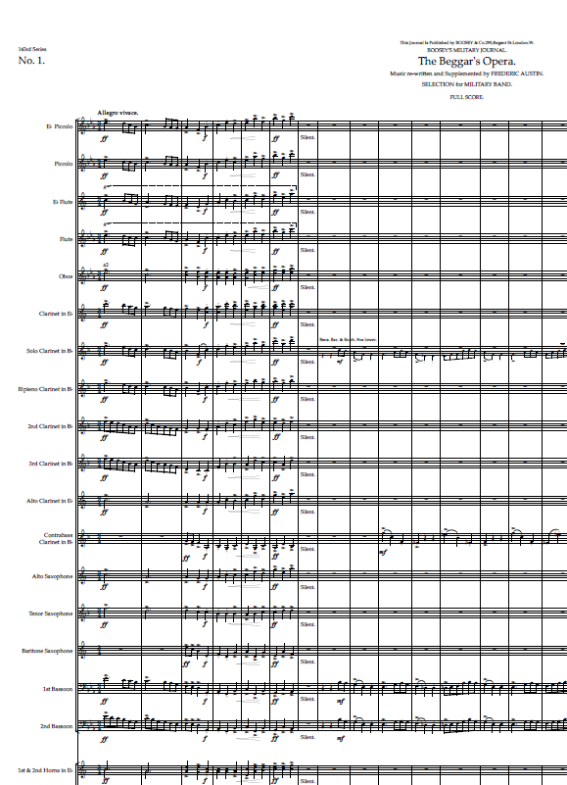
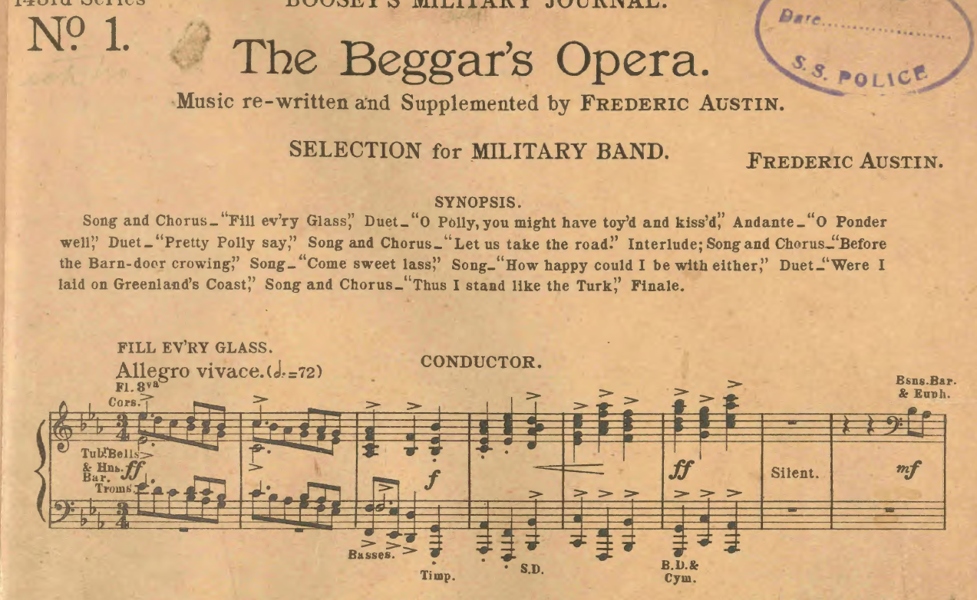

Digital Realisations
The Beggar’s Opera (John Gay; Frederic Austin)

Slide 15
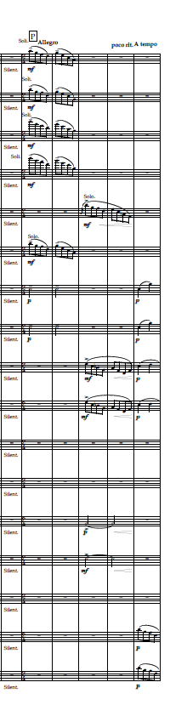
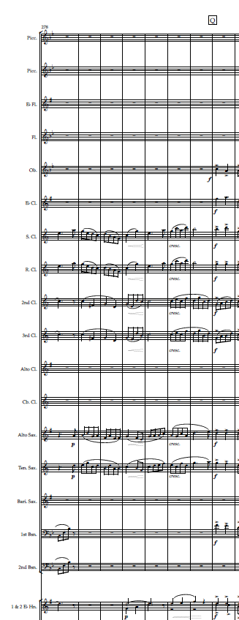
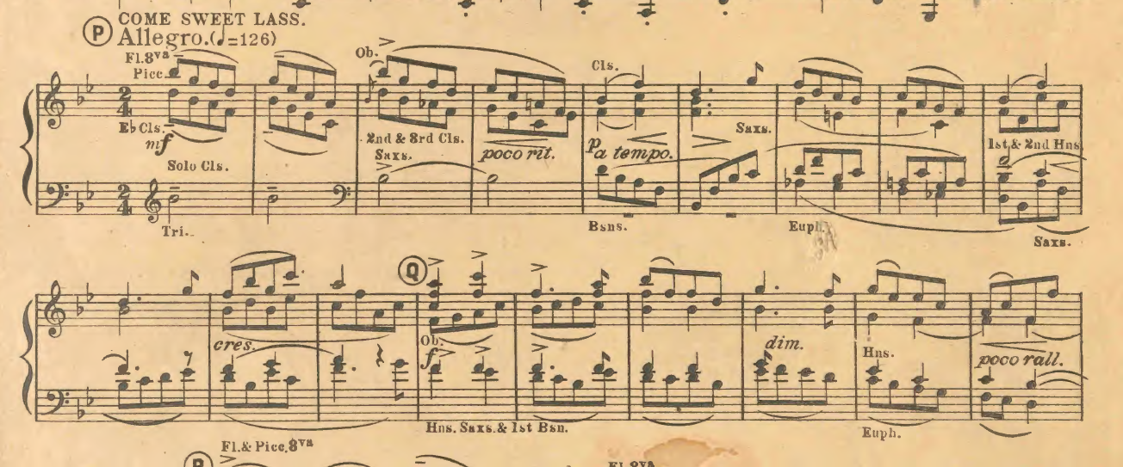
The Beggar’s Opera
(John Gay; Frederic Austin)

Slide 16
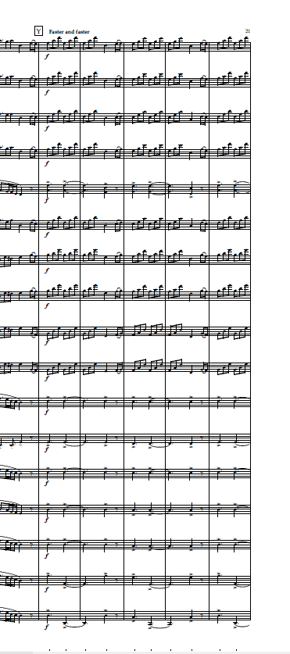
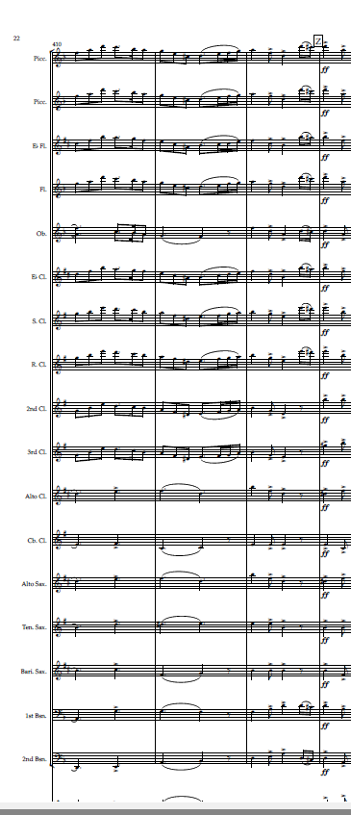
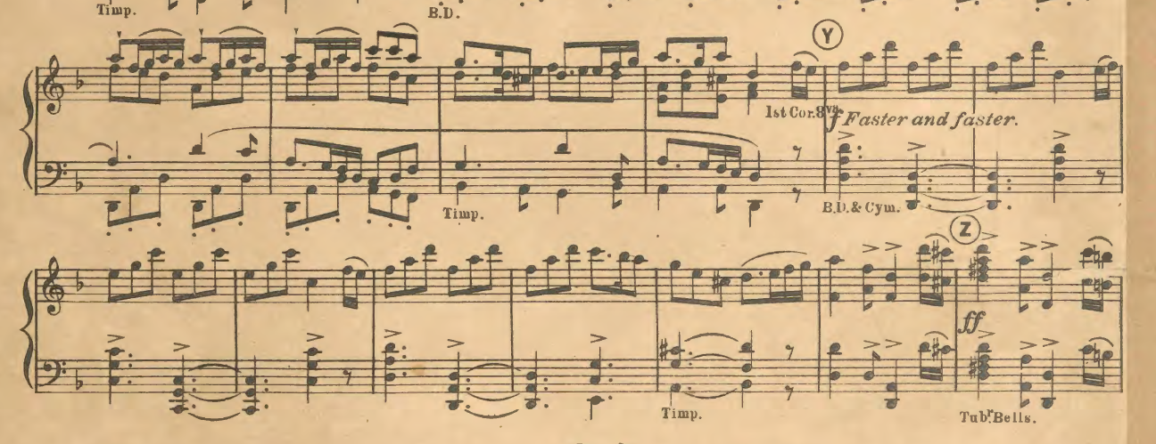
The Beggar’s Opera
(John Gay) by Frederic Austin

Slide 17
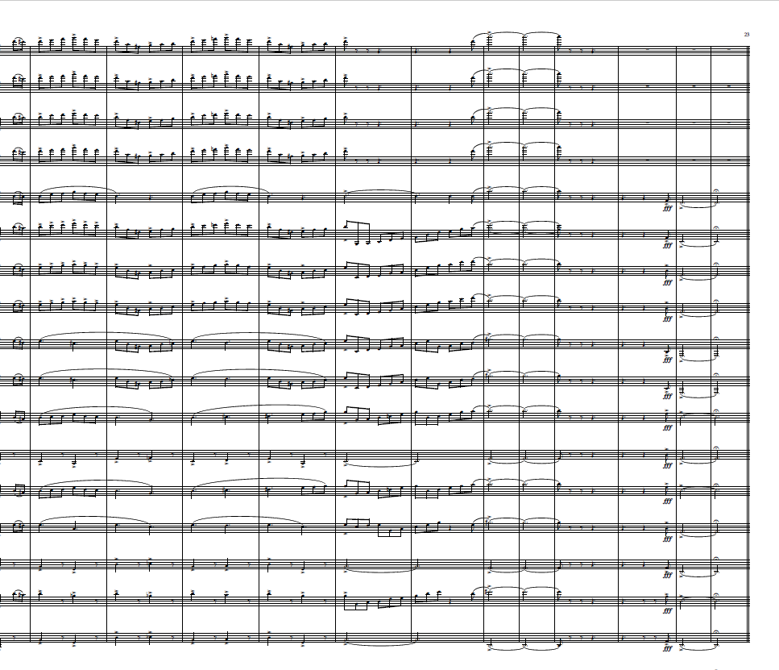
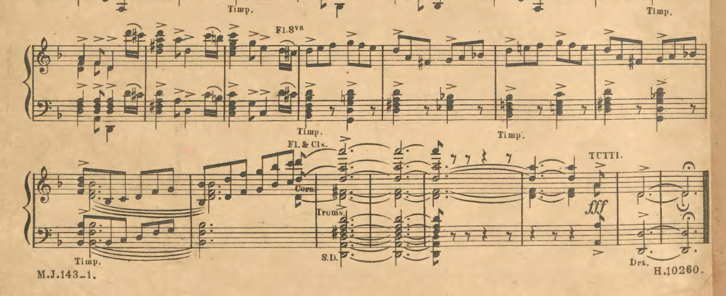
The Beggar’s Opera
(John Gay; Frederic Austin

Slide 18
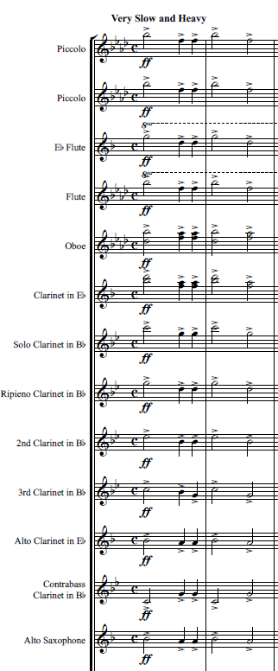
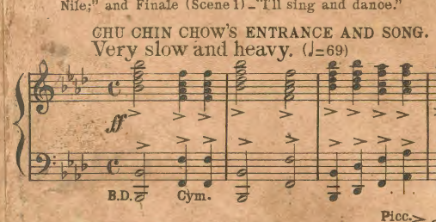
Chu Chin Chow

Slide 19
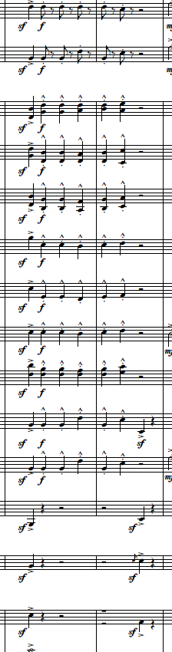
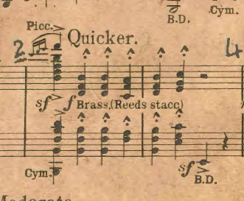
Chu Chin Chow

Slide 20
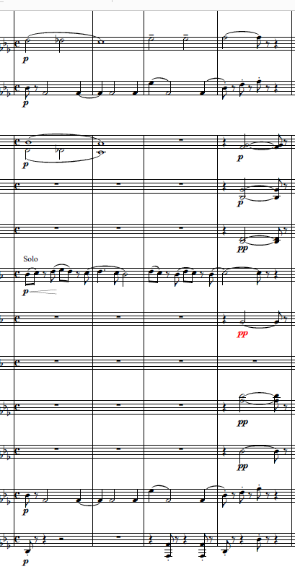
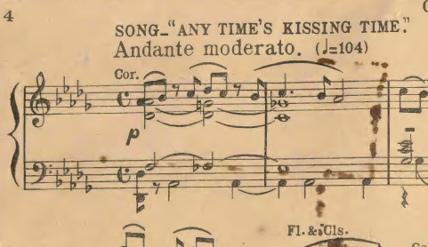
Chu Chin Chow

Slide 21
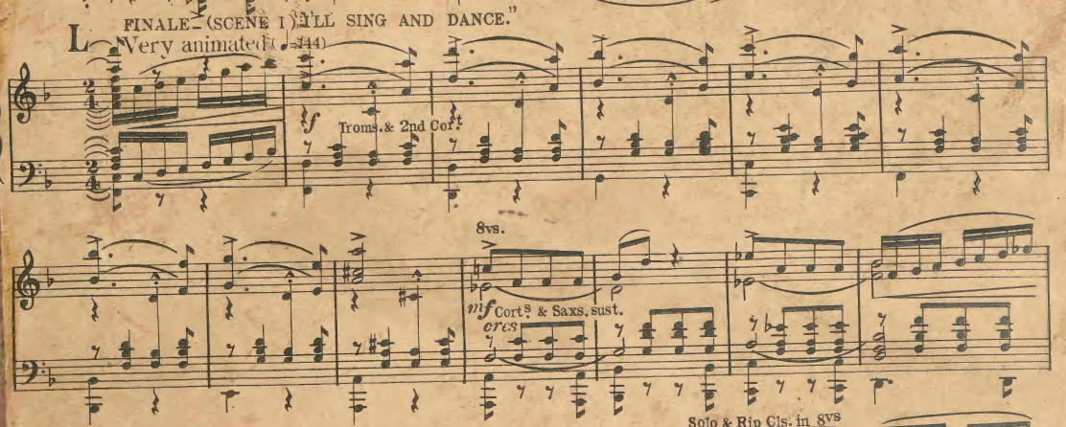
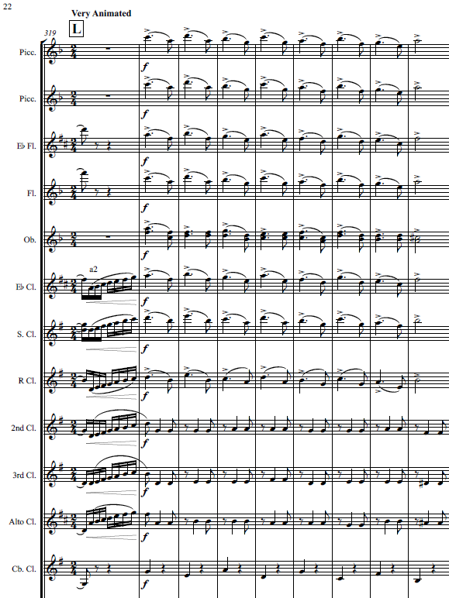
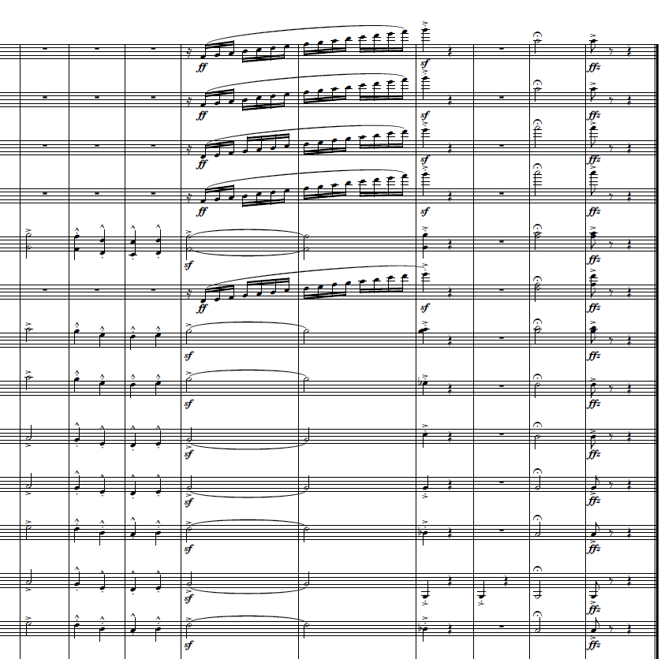
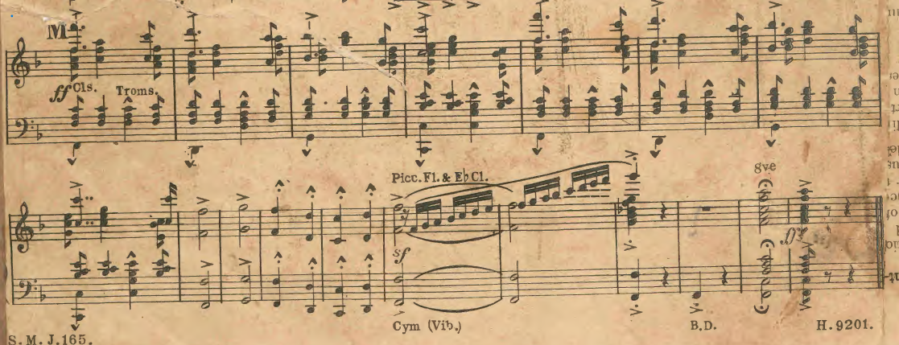
Chu Chin Chow

Slide 22
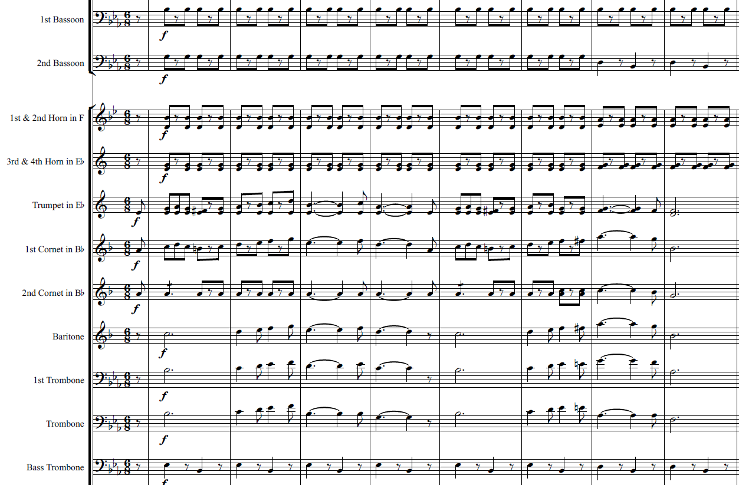
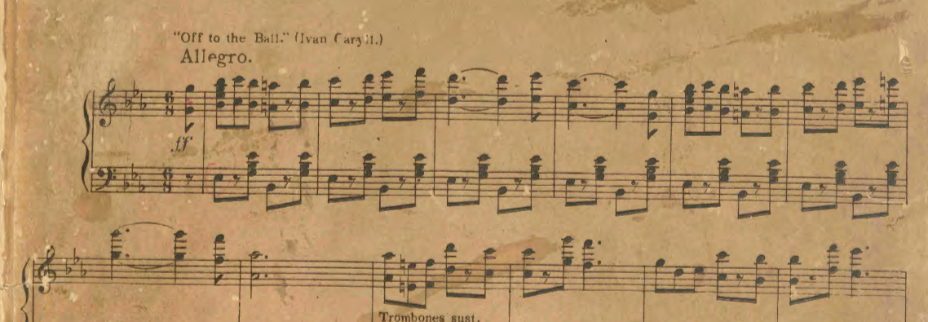
The Orchid

Slide 23
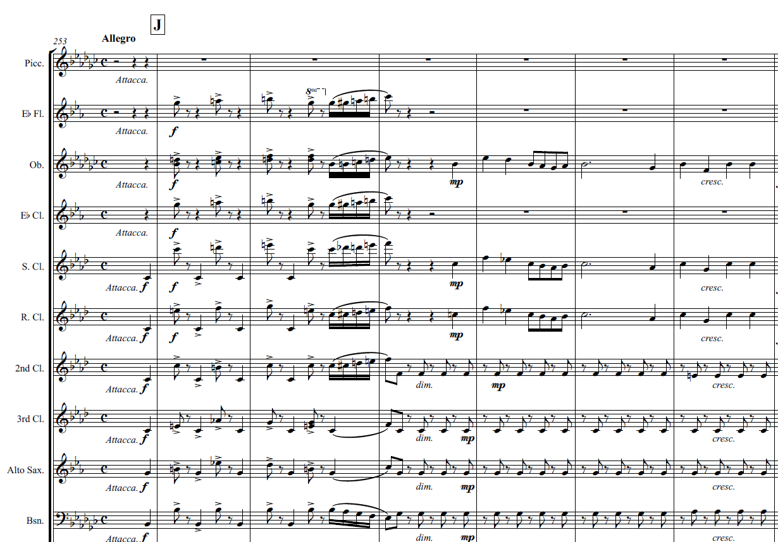
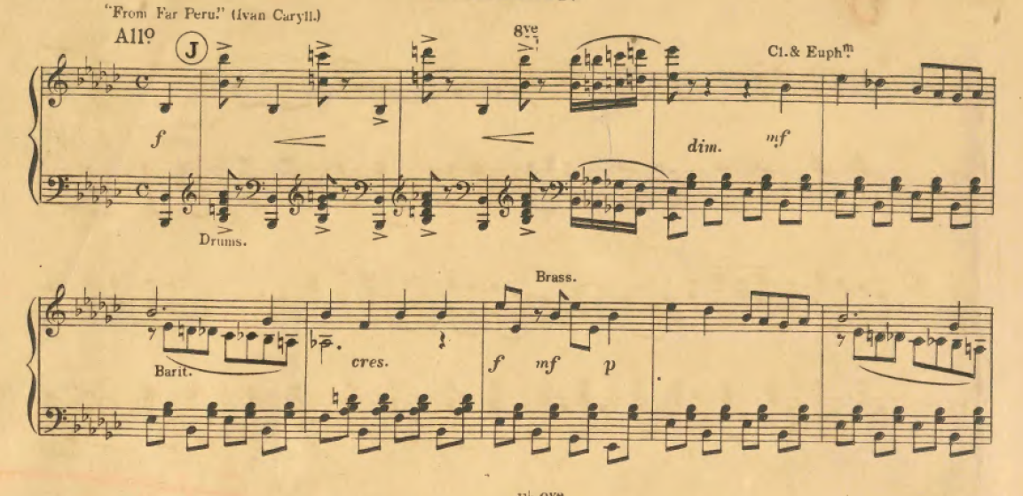
The Orchid

Slide 24
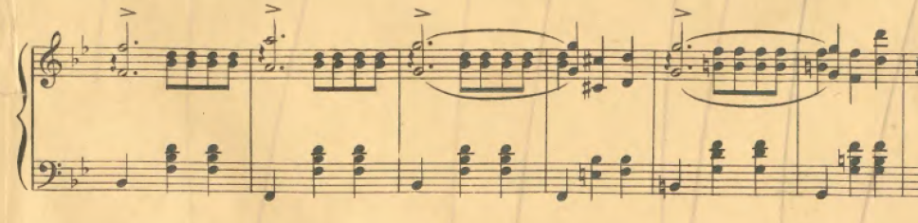
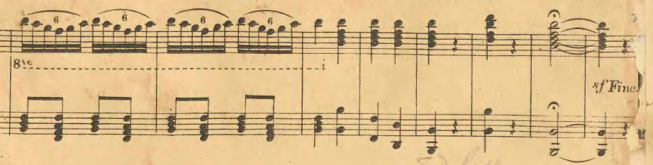
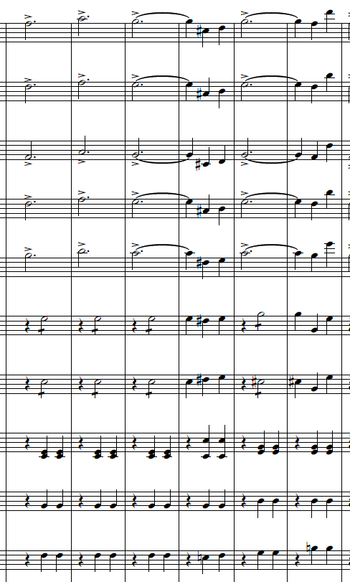
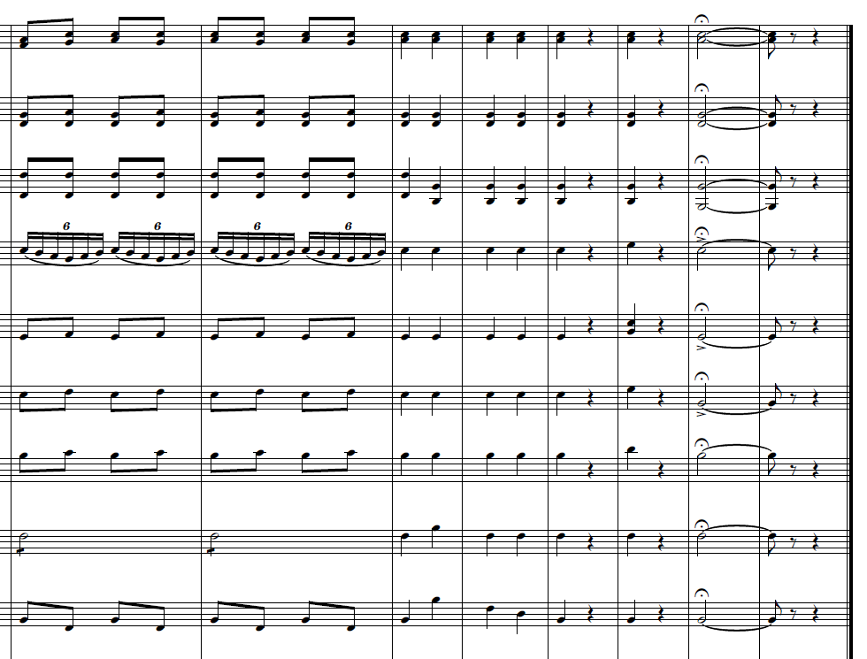
The Orchid

Slide 25
Beggars Opera
 | Source | Performance Date | Location | Conductor
1 | The Straits Times, 16 September 1927, Page 10 | 16 September 1927 | Outside Victoria Theatre 5.15pm Beggars Opera (Austin) | SS Police Band F. E. Minns
2 | The Singapore Free Press and Mercantile Advertiser (1884-1942), 2 December 1927, Page 8 | 2 December 1927 | Outside Victoria Theatre Beggars Opera (Austin) | SS Police Band No mention
3 | The Singapore Free Press and Mercantile Advertiser (1884-1942), 27 February 1931, Page 20 | 27 February 1931 | Katong Park Beggars Opera (Austin) | SS Police Band No mention
4 | The Straits Times, 20 October 1931, Page 5 | 21 October 1931 | Botanic Gardens Beggars Opera (Gay) | SS Police Band No mention
5 | The Singapore Free Press and Mercantile Advertiser (1884-1942), 1 August 1933, Page 8 | 2 August 1933 | Telok Ayer 9pm Beggars Opera (Gay) | SS Police Band No mention
6 | The Singapore Free Press and Mercantile Advertiser (1884-1942), 6 February 1935, Page 2 | 6 February 1935 | Telok Ayer, 5:15pm (Beggars Opera – Austin) | SS Police Band F.E Minns

Slide 26
Chu Chin Chow
S/No | Source | Performance Date | Location | Conductor
1 | The Straits Times, 14 April 1927, Page 10 | 1927 April 15 | Lawn of Seaview Hotel | F. E. Minns
2 | The Straits Times, 5 May 1927, Page 10 | 1927 May 5 | Bandstand | F. E. Minns
3 | The Singapore Free Press and Mercantile Advertiser, 8 July 1927, Page 8 | 1927 July 8 | Waterloo Street | no mention
4 | The Straits Times, 29 September 1927, Page 8 | 1927 September 30 | Outside Victoria Theatre | F. E. Minns
5 | The Straits Times, 8 May 1928, Page 10 | 1928 May 9 | Outside Victoria Theatre | no mention
6 | The Singapore Free Press and Mercantile Advertiser, 21 January 1931, Page 2 | 1931 January 21 | Waterloo Street | F. E. Minns
7 | Malaya Tribune, 26 May 1931, Page 7 | 1931 May 27 | Botanic Gardens | F. E. Minns
8 | The Straits Times, 11 August 1932, Page 18 | 1932 August 11 | Katong Park | no mention

Slide 27
Chu Chin Chow
S/No | Source | Performance Date | Location | Conductor
9 | Malaya Tribune, 17 April 1935, Page 5 | 1935 April 17 | Katong Park | no mention
10 | The Singapore Free Press and Mercantile Advertiser, 4 April 1936, Page 2 | 1936 April 5 | Botanic Gardens | J.C. Hitch
11 | Sunday Tribune (Singapore), 17 October 1937, Page 2 | 1937 October 17 | Botanic Gardens | no mention
12 | Morning Tribune, 26 March 1938, Page 8 | 1938 March 31 | Botanic Gardens | J.C. Hitch
13 | Morning Tribune, 18 March 1939, Page 17 | 1939 March 23 | Farrer Park | S. Chapman
14 | The Singapore Free Press and Mercantile Advertiser, 24 March 1939, Page 7 | 1939 March 29 | Katong Park | S. Chapman
15 | The Singapore Free Press and Mercantile Advertiser, 26 August 1939, Page 7 | 1939 August 27 | Botanic Gardens | S. Chapman
16 | The Straits Times, 3 December 1939, Page 3 | 1939 December 4 | Farrer Park | no mention

Slide 28
The Orchid
S/No | Source | Performance Date | Location | Conductor
1 | Pinang Gazette and Straits Chronicle, 19 November 1923, Page 4 | 1923 November 19 | Esplanade | Municipal Band
2 | The Singapore Free Press and Mercantile Advertiser, 8 December 1927, Page 8 | 1927 December 9 | Outside Victoria Theatre | No mention
3 | The Singapore Free Press and Mercantile Advertiser, 13 August 1929, Page 8 | 1929 August 13 | Waterloo Street | H.B. Graves
4 | The Straits Times, 7 June 1930, Page 17 | 1930 June 8 | Botanic Gardens | no mention
5 | Malaya Tribune, 22 May 1931, Page 7 | 1931 May 22 | Katong Park | G. Hinter
6 | The Straits Times, 16 June 1932, Page 12 | 1932 June 16 | Katong Park | no mention
7 | Malaya Tribune, 12 May 1936, Page 14 | 1936 May 12 | Waterloo Street | no mention
8 | Malaya Tribune, 5 June 1936, Page 16 | 1936 June 5 | Katong Park | J.C. Hitch
9 | The Singapore Free Press and Mercantile Advertiser, 8 June 1936, Page 2 | 1936 June 9 | Waterloo Street | J.C. Hitch

Slide 29
The Orchid
S/No | Source | Performance Date | Location | Conductor
10 | Morning Tribune, 14 December 1936, Page 24 | 1936 December 15 | Katong Park | J.C. Hitch
11 | The Singapore Free Press and Mercantile Advertiser, 18 December 1936, Page 6 | 1936 December 18 | Botanic Gardens | no mention
12 | The Singapore Free Press and Mercantile Advertiser, 8 January 1937, Page 7 | 1937 January 8 | Botanic Gardens | J.C. Hitch
13 | The Singapore Free Press and Mercantile Advertiser, 15 June 1937, Page 2 | 1937 June 15 | Telok Ayer | no mention
14 | Malaya Tribune, 4 November 1937, Page 16 | 1937 November 4 | Katong Park | no mention
15 | Morning Tribune, 2 December 1937, Page 21 | 1937 December 2 | Telok Ayer | J.C. Hitch
16 | The Straits Times, 16 December 1937, Page 17 | 1937 December 19 | Botanic Gardens | no mention
17 | Malaya Tribune, 14 May 1940, Page 3 | 1940 May 14 | Farrer Park | J.C. Hitch

Slide 30
Second Straits Settlement Police Band
The Second Straits Settlement Police Band [SSSPB hereafter] was reportedly formed in 1925…to add to the atmosphere and provide entertainment at police functions. Following an audition held in India, successful candidates–all of them with musical background—were brought to Singapore to form a 32-instrument band.
Oral accounts recall the formation of SSSPB with eleven woodwind players, twenty brass players, a side drum and bass drum player; the performers were mainly Punjabis.
(Dairianathan 2006, 35)

Slide 31
SSSPB Repertoire
Broadly categorized into Wind Ensemble arrangements of:
Euro-American instrumental and opera repertoire (Beethoven, Wagner, Gilbert & Sullivan etc.,);
Musical Theatre (e.g., Chu Chin Chow and The Orchid); and,
Arrangements of miscellaneous music pieces with exotic themes (e.g., Geisha, Two Hindoo Pictures).

Slide 32
Band Director
SSSPB was directed first by F.E. Minns till 1935 and was succeeded by J.C. Hitch.
The SSSPB in the 1920s was one of the sources of Western music available to the public at large: the earliest influences - shall we say, for the ordinary people, was the Police Band [sic]
(Paul Abisheganaden, in Dairianathan 2006; 35, emphasis in original).

Slide 33
F.E. Minns
Chief Inspector Minns will long be remembered by Singaporeans for his part in providing the orchestral accompaniment for the Gilbert and Sullivan Productions of the Singapore Amateur Operatic Society.
In those days the musical score of the Sullivan operas was subject to certain copyright restrictions; and I recall Minns spent many of his leisure hours for some months in transcribing by hand all the band parts for one of these productions
(Alec Dixon cited in Dairianathan 2006, 36)

Slide 34
F.E. Minns
The production is well served by its musical director, Mr. F. E. Minns and the orchestra. Often the work of the orchestra is overlooked, but its part in such a production as The Sorcerer [Gilbert and Sullivan] is a very important one, and the members are to be congratulated on their good work. Mr. Minns who did all the orchestration himself, is a big asset to the A .D. C. [Amateur Dramatic Company] musical productions.
Straits Budget, 8 July 1926, Page 8
The principals were very good, the choruses, sung by a chorus larger probably than any that has supported a production of this kind in Singapore before, were splendid, and a full orchestra, supplemented by members of the Police Band [sic], and ably conducted by Mr. F. Minns, did full justice to the fine music.
The Singapore Free Press and Mercantile Advertiser, 25 March 1927, Page 16

Slide 35
SSSPB during the Japanese Occupation
Syonan Times 17 June 1942: The Syonan Police Band will perform at the Waterloo Street bandstand today from 7pm-8pm. [conducted by Mr. Ganda Singh]
Syonan Times 15 June 1944, The Syonan Police Band will perform at Hong Lim Green from 7-8 pm on Sunday offering repertoire such as Kogun No Sieka and Military Band I.
Syonan Times June 11 1944, at Jalan Besar and 14th June at the Botanical Gardens. (Dairianathan 2006, 37)

Slide 36
Technology and Affordance/s
‘human beings have puzzled over…something they acquire without knowing how, that they possess but which something possesses them even more, that is not a part of them but without which they would not be what they are’
(Sigaut 2002, p. 421).
Sigaut, citing Lynn White (1940), positions material actions ‘in the sense that they all make a material change in something; and that they are intentional and are so on several levels… the social goals have taken the form of material needs and these have become the agent’s true goals… the activities… are not simply material, they are “intentionally” material’ (Sigaut 2002, p. 424, emphasis in original).

Slide 37
Technology and Affordance/s
‘What should be used as the basis for identifying operations: ‘our’ sciences or ‘native’ knowledge? The answer to this question depends on how well the one translates into the other’ (Sigaut 2002, p. 425).
(Sigaut, F. (2002) [1994]. Technology, pp. 420-59, in T. Ingold (ed.) Companion encyclopedia of anthropology. New York: Routledge.)

Slide 38
Reflections
What have we learnt from converting individual instrumental part scores into digital wind ensemble scores and audio realisations?
Has there been an/y understanding or meaning-making by re/living soundscapes from a past hitherto not heard, albeit digitally?
Should we use current technological affordances to real/ise and re/live music from past public spaces in Singapore?
What meanings do these digital realisations of past repertoire connect with the musical practices of Wind ensembles in Singapore?
What and how do these digital affordances impact public-funded Music education, in in-curriculum time classroom and CCA Wind ensembles?

Slide 39
Reflections
Technological affordances:
Contribute to an informed reading and understanding of archival wind ensemble scores, how musical part scores were not entirely without ‘deviations’ in terms of note inaccuracies, mis/aligned notes, etc.
Enable Wind Ensemble Conductors to learn how to discern and make editorial decisions on discrepancies in the score, enabling their learning of harmonic and compositional skills, given their expert aural/oral experiences in their practice.
Illuminate repertoire, instrumentation and orchestration for a uniquely emergent SSSPB public performance soundscapes in early 20th century Singapore. SSSPB’s reliance on Military Journal Music part scores is also a revelation of curatorial practices by a conductor (assuming autonomy of decision making) as much as the musicians.
Provide clues to social contexts surrounding music composed and published was as much contemporary as historical and had public dissemination as public ingratiation and repertoire building.

Slide 40
Reflections
Technological affordances
Short-circuit labour and time-intensive processes towards a physical realisation.
SSSPB’s public repertoire is now only a technological affordance away. Digital audio realisations contribute towards an informed understanding of Singapore’s public musical heritage through SSSPB.
Mitigate virtual (AVID-SIBELIUS) entities with physicality as technology, with consequent behaviours and outcomes (reading, rehearsing and performing).
Provide opportunities – visual and aural –for more inclusive forms of learning – formal, informal and non-formal – for present and future Wind Ensemble participants towards physical performances.

Slide 41
Reflections
Technological affordances into the present not including AI software may be able to scan scores better than NotateMe.
Composers/Arrangers past and present have had to make do with instruments, ensembles, and performers to play their music. Their instrumentation and emergent soundscape demonstrate this adaptability.
NotePerformer references modern day instruments. If future software could recreate the sounds of the instruments in the 1920s, a past soundscape via technological affordances offer for a very valuable lesson in heritage soundscapes.

Slide 42
Reflections
Repertoire performed by SSSPB at public outreach concerts provide educational potential for researchers, conductors, wind ensemble participants and audiences.
SSSPB, SPF Band today, will be 100 years in 2025, evidence of sustained and sustainable musical history and heritage.
Singapore’s public-funded education supports learners engaging in out-of-in-curriculum time – co-curricula (CCA) – activities, of which the Wind Ensemble is one.
Singapore’s musical identity as heritage and heir/itage, has potential value in educational capital in policy documents on mandatory, indicative and dynamic repertoire in its public-funded General Music Programme for schools.

Slide 43
Thank You!

Slide 44
References
Bates, V. C., & Talbot, B. C. (2014). Technology and music education in a digitized, disembodied, posthuman world. Action, Criticism, and Theory for Music Education, 13(2), 30.
Beggars Opera (Composer John Gay; Frederic Austin), 522_Box1_Acc no.522-2016, to 531-2016, SPF Band Heritage Music Scores from the SPF Band/Singapore Police Force, courtesy of the National Archives of Singapore (19 March 2019, obtained 14 July 2021).​
Chu Chin Chow (Composer Frederick Norton), 695_2016, Box 19_Acc No. 693_2016 to 704_2016, no. 173, SPF Band Heritage Music Scores from the SPF Band/Singapore Police Force, courtesy of the National Archives of Singapore (19 March 2019, obtained 14 July 2021).​
The Orchid (Composer Ivan Caryll & Lionel Monckton, Arranged by Dan Godfrey), 540_2016, Box 2_Acc No. 532_2016 to 541_2016, no.19, SPF Band Heritage Music Scores from the SPF Band/Singapore Police Force, courtesy of the National Archives of Singapore (19 March 2019, obtained 14 July 2021).
Dairianathan, E. (2006). The wind band ensemble in Singapore: presence and practice. Journal of the world association for symphonic bands and ensembles, 13, 31-50.
Frederickson, J. (1989). Technology and Music Performance in the Age of Mechanical Reproduction. International Review of the Aesthetics and Sociology of Music, 20(2), 193–220. Retrieved October 07, 2019, from https://www.jstor.org/stable/836729Gibson, J. J. (2015;1986;1979). The ecological approach to visual perception: classic edition. Psychology press.
Ingold, T. (2016). Lines: A brief history. Routledge.
Mass print media articles found in https://eresources.nlb.gov.sg/newspapers/Digitised/Article/singfreepressb19310527-1.2.47?ST=1&AT=search&k=Chu%20Chin%20Chow%20and%20Police%20Band&QT=chu%2cchin%2cchow%2cand%2cpolice%2cband&oref=article
Maines, D. R., & Bridger, J. C. (1992). Narratives, community and land use decisions. The Social Science Journal, 29(4), 363-380
White, L. (1940). Technology and Invention in the Middle Ages. Speculum, 15(2), 141–159. https://www.jstor.org/stable/2849046
Notes:
Anymore to add?

