Slide 1
What can we do without using similarity and congruency?
Zhao Dongsheng
Mathematics and Mathematics Education
National Institute of Education
Mathematics Teachers Conference 2011

Slide 2
A B
Which of these two figures is a triangle?
What is the definition of a triangle?

Slide 3
Outline
Similarity and congruency---original definitions
and assumptions.
Teaching the two concepts in schools
-- how reasonable is the approach?
The roles for areas, circles, trigonometry and
others.
Similarity and congruency in reasoning training:
where to start, how far we can go?

Slide 4
Similarity and congruency(of triangles)
What is a triangle?
A closed figure consisting of three line segments linked end-to-end.
A 3-sided polygon. http://www.mathopenref.com/triangle.html
A triangle is a closed figure with three sides
http://www.geom.uiuc.edu/~wanous/definitionofatriangle.html
A triangle is one of the basic shapes of geometry: a polygon with three
corners or vertices and three sides or edges which are line segments.
http://en.wikipedia.org/wiki/Triangle
The plane figure formed by connecting three points not in a straight line
by straight line segments; a three-sided polygon.
http://www.thefreedictionary.com/triangle
A plane figure formed by having three straight edges as its sides is called
a triangle(one text book)

Slide 5
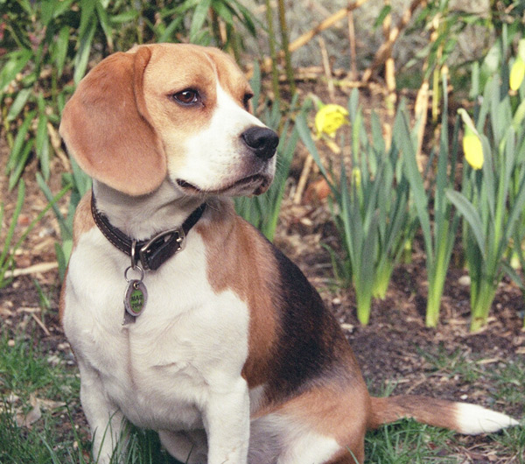
What is a dog ?
http://www.google.com.sg/search?q=picture+of+dog&hl=en&biw=1259&bih=604&prmd=ivns&tbm=isch&tbo=u&source=univ&sa=X&ei=HOzmTYu4GoS6sQPrj8H0DQ&ved=0CCMQsAQ

Slide 6
To give a formal definition of triangle, we have to define
line segments
To define line segment, we have to define
“points between two points”
To define “points between to points, we need to assume
some axioms on points
For all these, we need to know what is a point, line
these are undefined

Slide 7
Axiomatic structure of Euclidean plane geometry
Undefined terms:
Point, line, between , distance, angle measure
Axioms
1(The Existence Postulate)
The collection of all points forms a nonempty set(called the plane). There is more than one point in that set.
2 (The Incidence Postulate).
Every line is a set of points. For every pair of distinct points
A and B there is exactly one line l containing both A and B.

Slide 8
3 (The Ruler Postulate)
For every two points A and B there exists a real number
d(A, B),
called the distance from A to B.
For each line l there is a one-to-one correspondence between f: l →R such that if A and B are points on l
then d(A,B)=| f(x)- f(y)|.

Slide 9
Definition Let A, B and C be three distinct points.
The point C is between A and B, if C is on the line containing A, B and
d(A, B)= d(A,C)+ d(C,B).
The line segment AB consisting of points C between A and B as well as A and B.
Using a similar method, we can define rays

Slide 10
4( The Plane Separation Postulate). For every line l, the points that do not lie on l form two disjoint, nonempty sets H₁ and H₂, called half-planes bounded by l, such that the following two conditions are satisfied:
(1) H₁ and H₂ and are convex.
(2) If P is in H₁ and Q is in H₂ , then the segment
PQ intersects l.

Slide 11
Definition ( Angle) An angle is the union of two non-opposite rays and sharing the same endpoint. The angle is denoted by either .
The point A is called the vertex of the angle and the rays and are called the sides of the angle.
With another axiom—Protractor postulation, we can define the measure of an angle

Slide 12
Definition ( Triangle).
Let A, B and C be three non-collinear points. The triangle consists of the three segments
, that is
The points A, B and C are called the vertices of the triangle and the three segments are called the sides of the triangle.

Slide 13
A B

Slide 14
Two line segments are congruent if they have the same length .
Two angles are congruent if they have the same measure

Slide 15
congruent triangles
Definition (Congruent triangles) Two triangles are congruent if there is a correspondence between the vertices of the first triangle and the vertices of the second triangle such that corresponding angles are congruent and corresponding sides are congruent.

Slide 16
Do we really need the
six
congruencies of sides and angles to show the two triangles are congruent?

Slide 17
Proposition (The Side-Angle-Side Postulate or SAS). If and are two triangles such that
,
then .
This was first proved by Euclid as the Proposition 5. His proof is very complicated. Thus in many books, this was given as an assumption

Slide 18
Using SAS we can deduce other criterions in a simple way
SAS
ASA
AAS
SSS

Slide 19
Similar triangles
Definition (Similar triangles)
Two triangles are similar if there is a correspondence between their vertices such that the three corresponding angles are congruent and corresponding sides are proportional.
Theorem (AA)
If two corresponding angles of two triangles are congruent, then they are similar.
AA
SAS
SSS

Slide 20
2. Teaching the topics in schools
-- rigor / practical
The lower the level, the more the
undefined / assumptions
Primary:
Triangles are figures like the following ……
Secondary : A plane figure formed by having three straight edges as its sides is called a triangle(?) Plus illustrations.
JC: A triangle is a plane figure consists of three line segments connecting three non-colinear points

Slide 21
3. The roles for areas, circles,
trigonometry and others
Length :
Meter: The distance traveled by light in 1/299 792 458
seconds in vacuum
Smaller units: cm, mm, …
Larger Units: km, ..
Area:
1m×1m square: Area defined to be 1 m²
1cm×1cm square: Area defined to be 1 cm²

Slide 22
Area of rectangle:
Definition: Area of an a by b rectangle = ab
b
a
Area of a triangle:

Slide 23
Triangles ABC and CDA are congruent(?),
they have the same area.
Area of ΔABC = 1/2 Area of rectangle ABCD
=1/2 AB× BC

Slide 24
How about an arbitrary triangle?
Congruency of triangles is also used to deduce the area formula of a trapezium

Slide 25
Area of an polygon:
Each polygon can be decomposed as finite number of triangles. The area of the polygon equals the sum of areas of these triangles.

Slide 26
Definition of area of rectangle
Via congruent triangle
Formula of area of triangles
Formula of area of polygons
Without congruency of triangles, we even do not know what does it mean for the area of triangles

Slide 27
Congruency of triangles is also used in proving the famous Pythagoras Theorem:
a
b
c

Slide 28
Co-side Theorem and Co- Angle Theorem
(Zhang Jingzhong)
Express the ratio of lengths of segments as the ration of areas of some triangles.
Using these theorem one can deduce many other results
----- area method
See Chapter 4 of
“Plain Geometry----Theorems, examples, exercises”

Slide 29
Note that without in introduction of calculus we do not know what is the definition of the area (and how to find ) of a region like the following:

Slide 30
Similarity and trigonometric functions
For an angle θ, how do we define
sinθ ?
θ
sinθ = AB/ AO

Slide 31
But which point A we should choose?
It does not matter. The corresponding triangles are
similar.
The value are all equal to each other.

Slide 32
Properties of similar triangles guarantee that the trigonometric functions are well-defined

Slide 33
Some major properties of circles whose proofs involve similarity of triangles
Intersecting Chord Theorem:
If two chords of a circle intersect in the interior of a circle,
thus determine two segments in each chord, the product of the
lengths of the segments of one chord equals the product of the
lengths of the segments of the other chord.
AP⋅ BP=CP ⋅DP.

Slide 34
Tangent –Secant Theorem:
If from a point outside a circle a secant and a tangent are
drawn, the secant and its external segment is equal to the
square of the tangent.

Slide 35
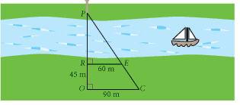
Other applications of similar triangles
---using the given lengths to find unknown length
Finding the height of a tree using the length of shadow
Find the width of a river
http://www.redmond.k12.or.us/14552011718214563/lib/14552011718214563/Lesson_11.3.pdf

Slide 36
3. In reasoning training
Plain geometry is the best platform to train school students reasoning skills
Where to start?
  Basic concepts
  Fundamental Axioms and theorems

Slide 37
Prove or not prove?
  No, if it is too complicated and no much students can
  learn from the proof
  For instance,
  the SSS test for congruency,
  AA, SAS, SSS tests for similarity
  Yes, if it is not too complicated and the method(s) is
  representative
  For instance,
  AAS test for congruency,
  Midpoint Theorem, Intercept Theorem,
  Intersecting Chord Theorem

Slide 38
Computation & proof
Computations often involve proofs
Example
Given the trapezium ABCD with ∠ABC a right angle. Find the area of the shaded region.
4cm
10cm
6cm

Slide 39
Without using similarity and congruency of triangles , what we can do is very limited.

Slide 40
Thank you!

